Slide 1
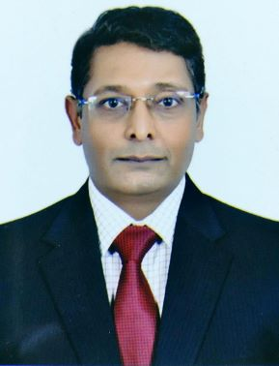
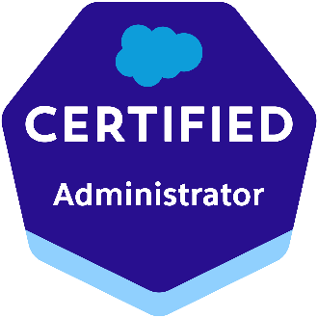

Rajesh Salesforce Administrator cum Project Manager
Certified Salesforce Administrator and experienced Salesforce Instructor and Project Manager
Good hands on experience on Salesforce Administration and Salesforce administration team development.
18+ years career spanning Development, Training, Team Building , Project Management and SAAS based Product Design and Development.
VERTICAL EXPERTISE
Technology
Healthcare
Facility Management
Manufacturing
Customer Support
CERTIFICATIONS
Salesforce Certified Administrator
OTHER PROFESSIONAL CERTIFICATIONS
Project Management Professional – PMP
(2006 ~ 2009)
SKILL HIGHLIGHTS
Salesforce administration
Salesforce custom application development
Agile Project Management
Requirement/Change Management
Custom SAAS Based Product Development
Languages: English, Hindi

